Slide 1

Secret Shop
Luxury watch collection

Slide 2
HOME
SHOP
ABOUT
CONTACT
CART

Slide 3
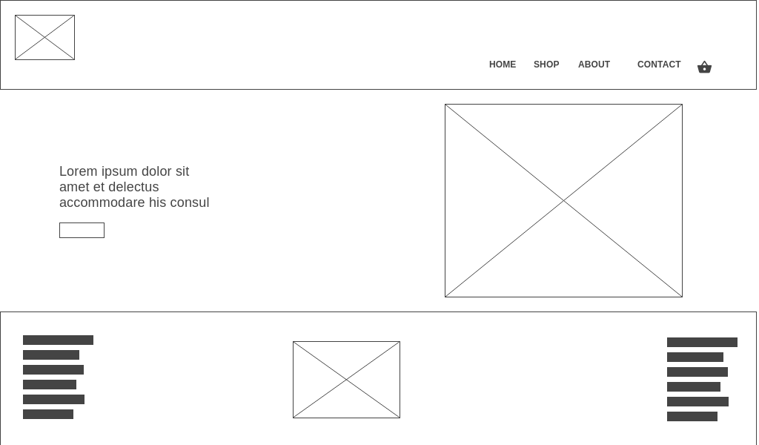

Slide 4
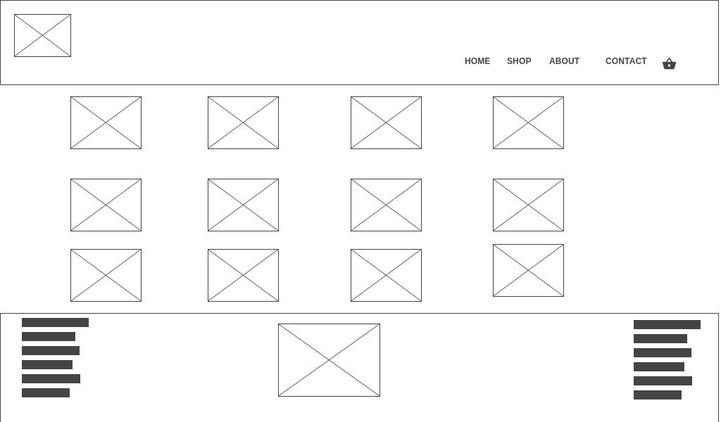

Slide 5
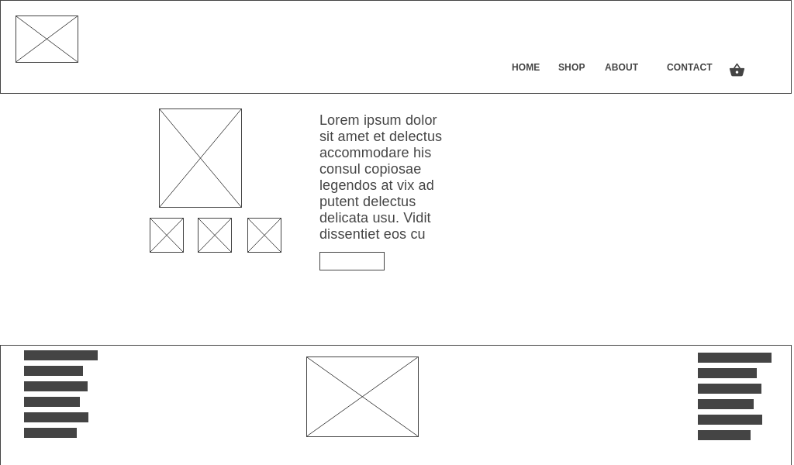

Slide 6
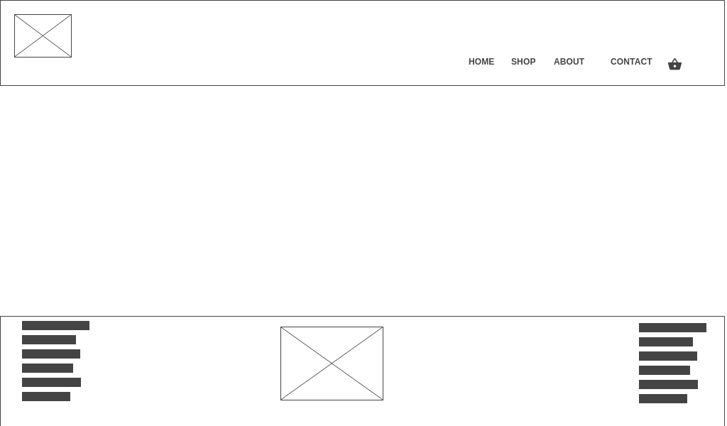

Slide 8
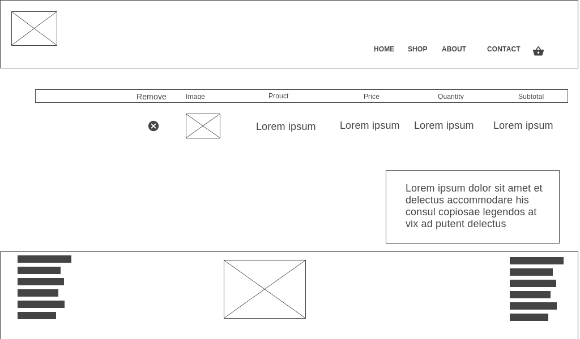

Slide 9
Providing Authentic watch
Luxury watches
Cheaper than Mall price
Collectors
Gift
Souvenir

Slide 10
Visual Studio
HTML
CSS
Javascript
Bootstrap
Google font

